Slide 1
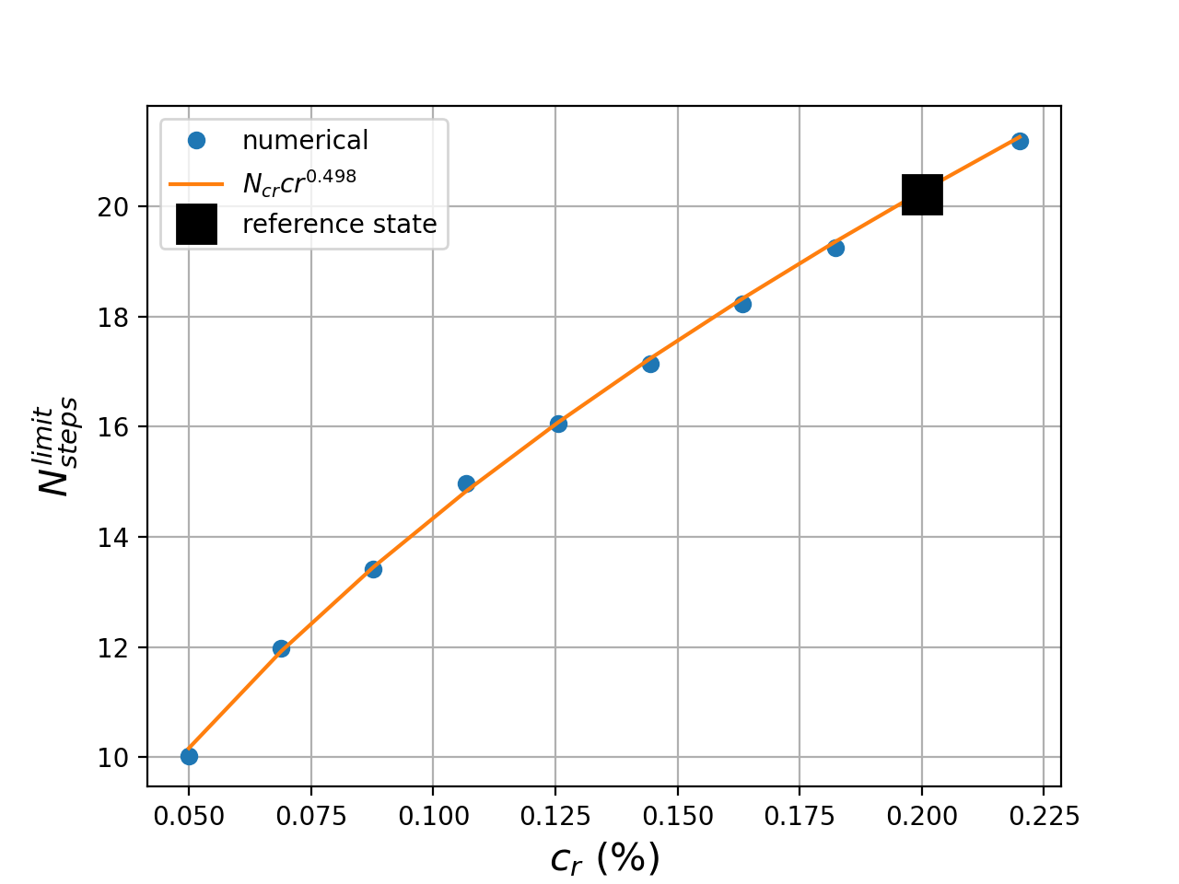
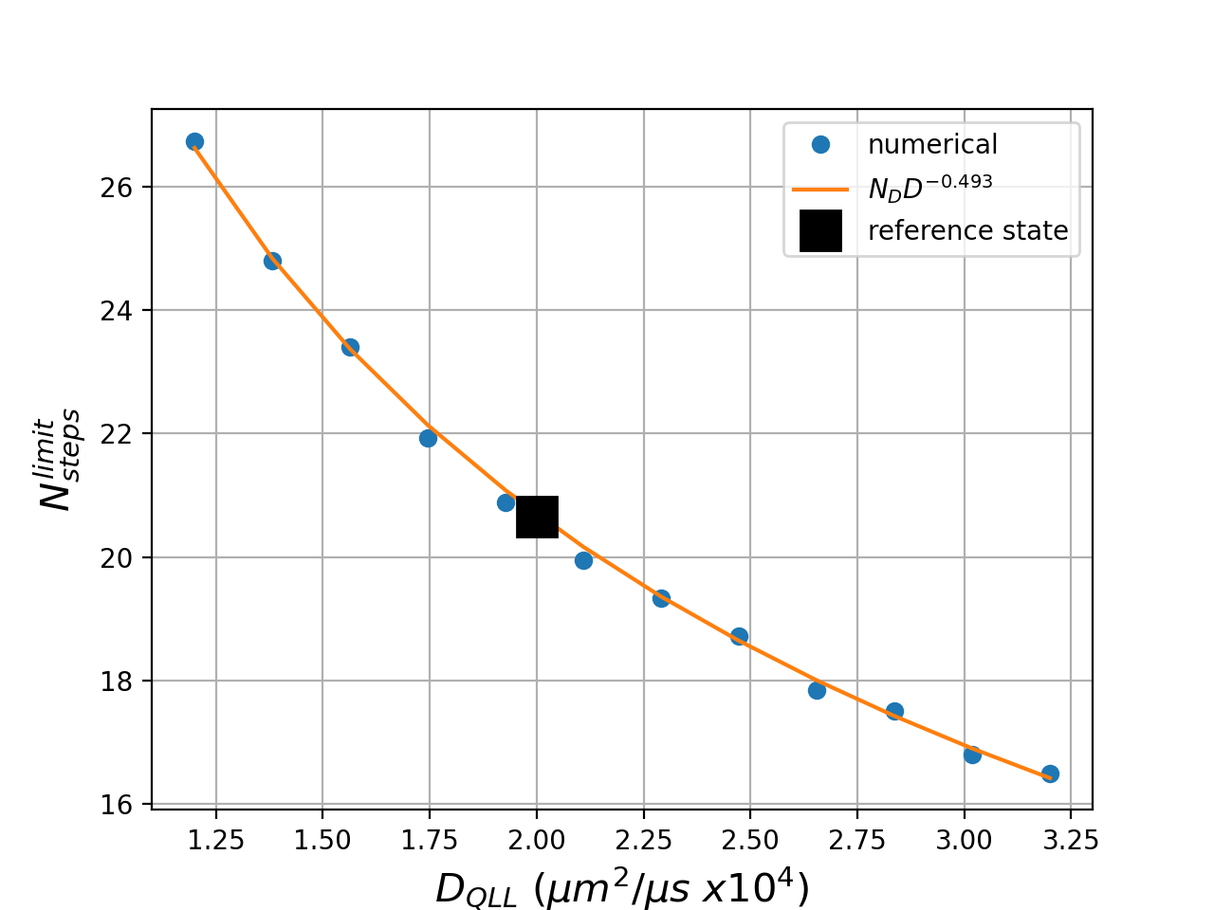
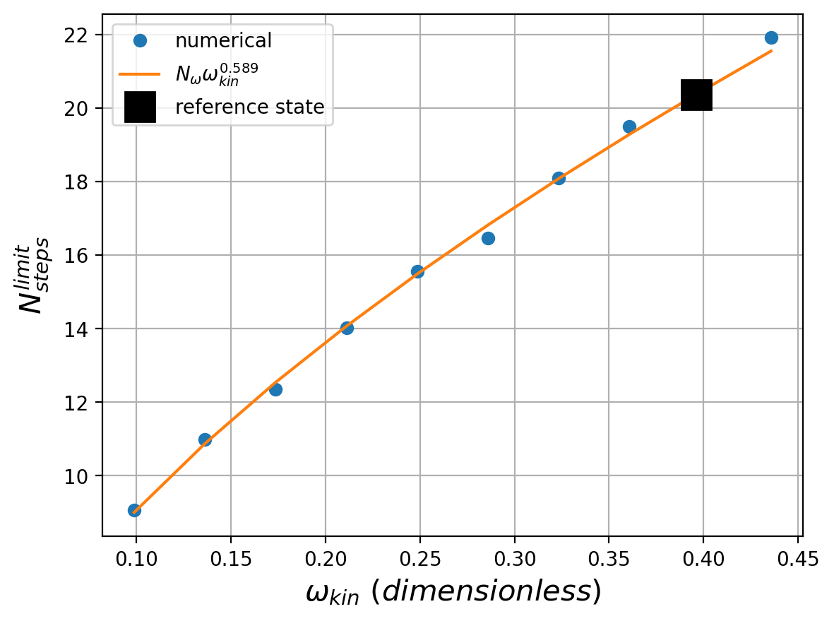
(a)
(b)
(c)
To get this in the form I needed for overleaf, I
Did a “save as” pdf
Opened in Preview, did a tools/rectangular selection/crop, then exported as png

